Slide 1
2024 Subject Selection
What, Why & How.

Slide 2
Subject Selection Timeline
Monday 26 June- Selections open
Wednesday 28 June- Parent Information Evening; Subject Selection Information Market 4:00pm- 6:30pm
Friday 21 July (Week 1 Term 3)- Selections Close

Slide 3
How to Select
On Monday 26 June all students received an email:
2024 Subject Selection.
Course information on APHS 121 should be referred to when choosing subjects.
https://sites.google.com/aphs.nsw.edu.au/stage-5-course-information/home
Use the link and WebCode below to log in to the subject selection portal .
STEP 1: Click: my.edval.education/login
STEP 2: Enter the following WebCode: XXXXX
STEP 3: Select subjects you want, in order of your PREFERENCE (Important).
STEP 4: Click [Submit].
STEP 5: Print out confirmation letter, have it signed by a parent and return to students services on your level.
Regards Mr Train
Deputy Principal

Slide 4
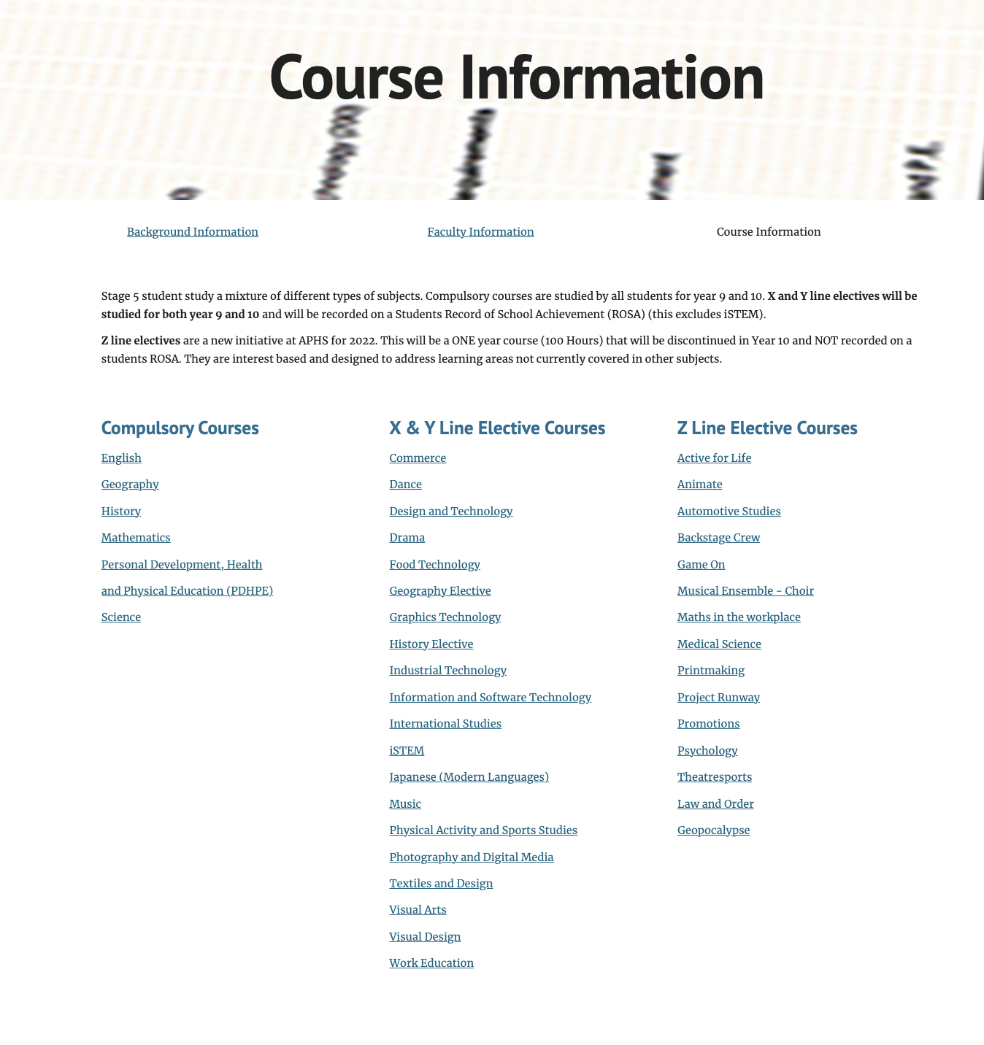
Subject Information
The APHS Connect 121 link will take you to an information page.
Here you will be able to find out information about subjects.
You should also speak with your teachers and attend the selection evening on Wednesday 28 June.

Slide 5
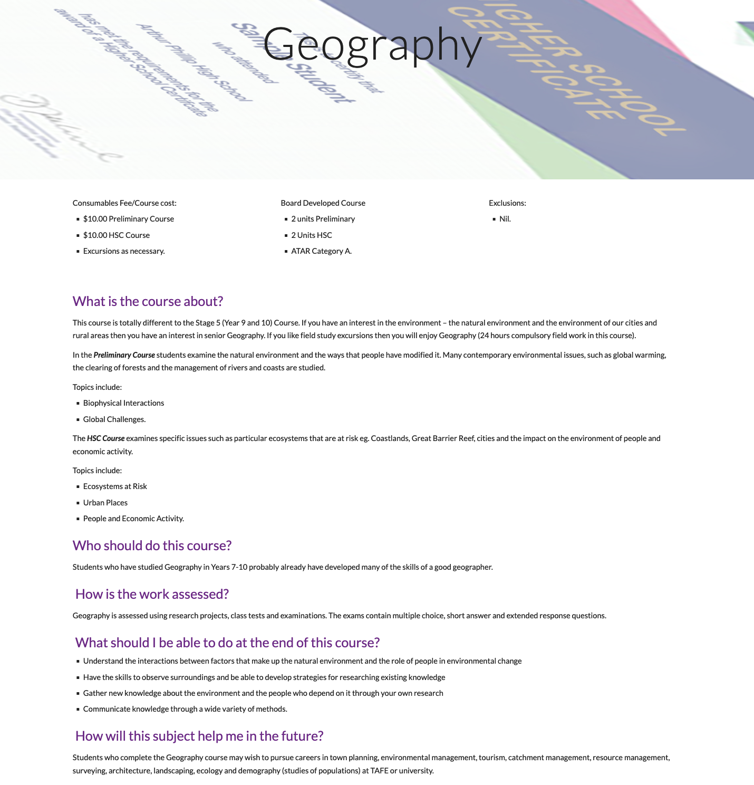
Subject Information

Slide 6
What subjects can I choose?
Yr 8 Students
Yr 8 students will study 3 electives in 2024.
They are advised to choose subjects that they are interested in rather than what their friends choose.
They will study 2 subjects for 2 years, we call these X and Y line electives
They will study 1 subject for year 9 only, we call this the Z line elective.
You will be asked to select subjects in order of preference, Select the one you would like most first, your second choice second etc.

Slide 7
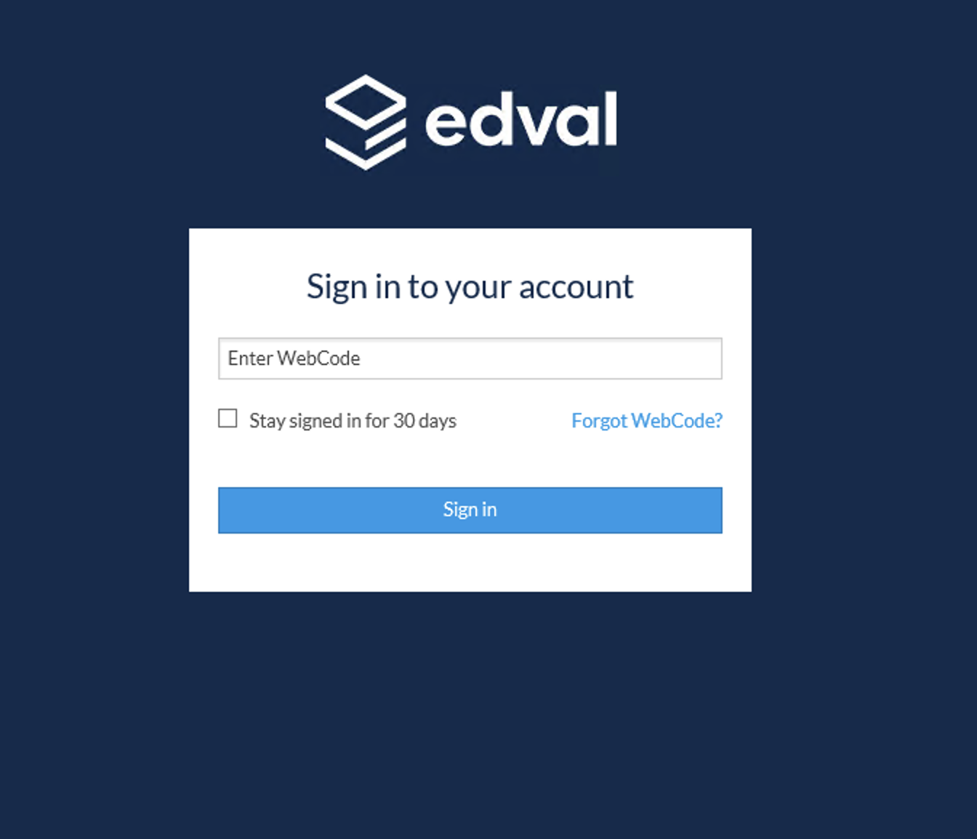
How to actually make your selection
Follow the Link in the email and log in using your WebCode.

Slide 8
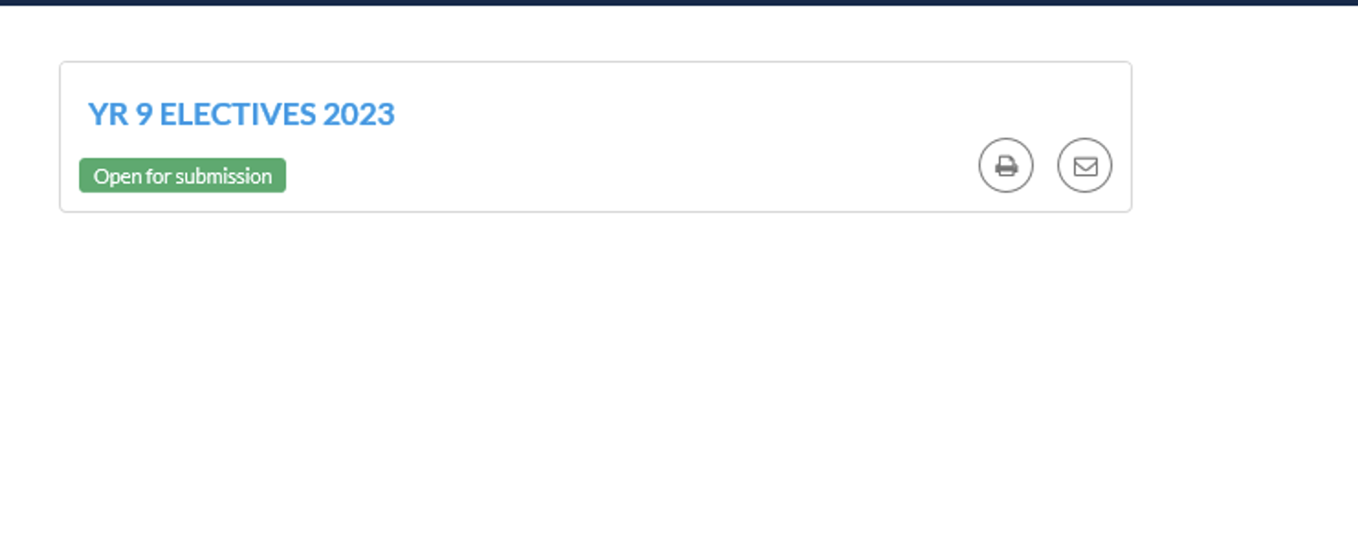
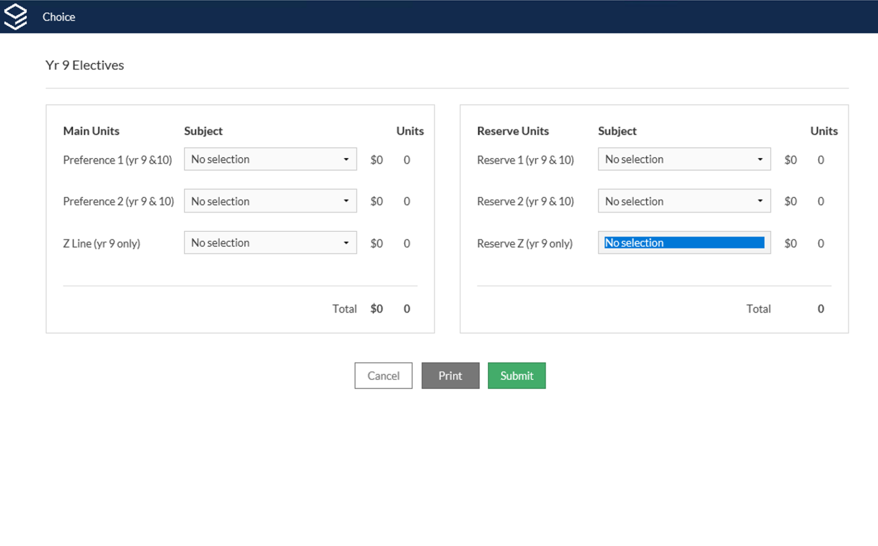
Year 8
Make your choices in preferential order.
Submit your form and print out the confirmation sheet.
Have your parents sign it and return to your student services desk.

Slide 9
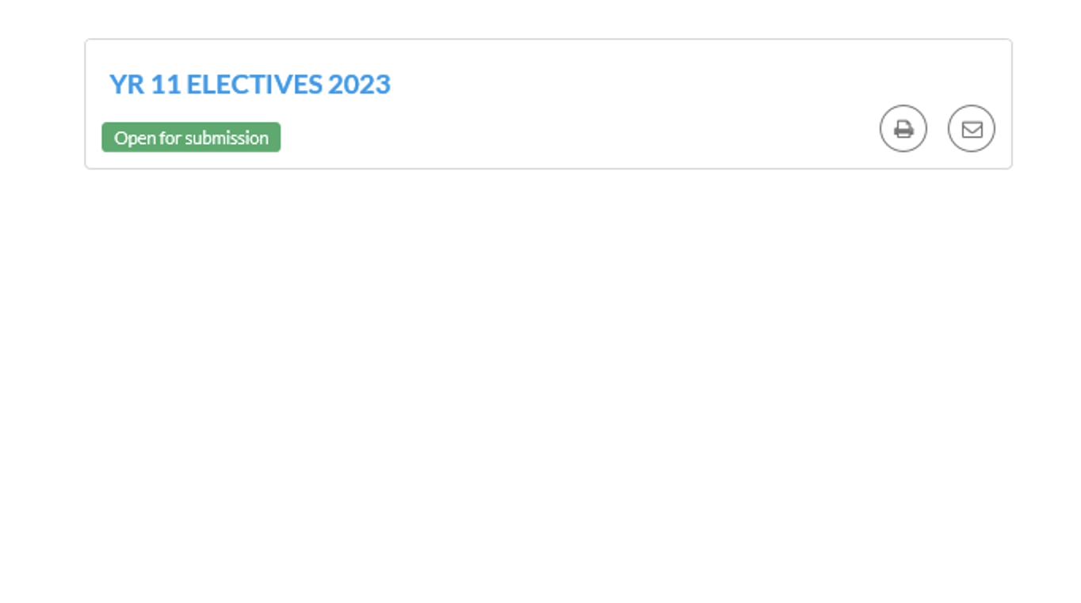
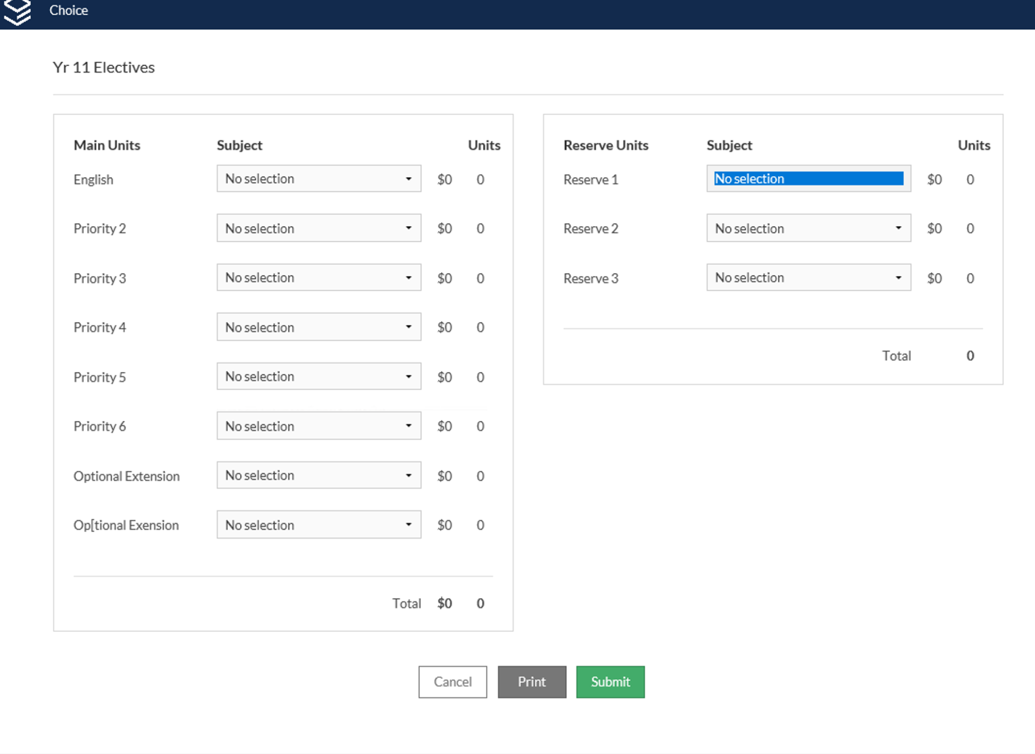
Year 10
Make your choices in preferential order.
Submit your form and print out the sheet.
Circle if you want an ATAR or not.
Have your parents sign the confirmation sheet and return to your student services desk.

Slide 10
What subjects can I choose?
Yr 10 Students
Students will need to study at least 12 Units or 6 subjects for Year 11. In Year 12 you must study 10 units as a minimum.
English the only compulsory subject.
You may wish to student an extension subject- Maths or English as a 13th unit.
If you want to go to university in 2026 you need to be ATAR eligible. You can study only 1 non ATAR subject. If you choose to drop a subject in year 12 this is the only one you can drop.

Slide 11
What happens next ?
After selections are closed all selections will be taken and lines developed.
This organises subjects into a timetable.
In early 2024 there will some room for change if there are places in the subjects you may prefer. Announcements about this process will be made next year.

Slide 12
Subject Selection Timeline- Again.
Monday 26 June- Selections open
Wednesday 28 June- Parent/ Subject Selection Information/ Market 4:00pm- 6:30pm
Friday 21 July (end of Week 1 Term 3) Selections Close

